Slide 1
Zips Electric Racing 2016 Electrical System
Joseph Drockton
Electrical Engineer
jmd115@zips.uakron.edu
Trevin Hartzler
Team Captain
tah91@zips.uakron.edu
Richard Johnson
EE Consultant
rcj10@zips.uakron.edu

Slide 2
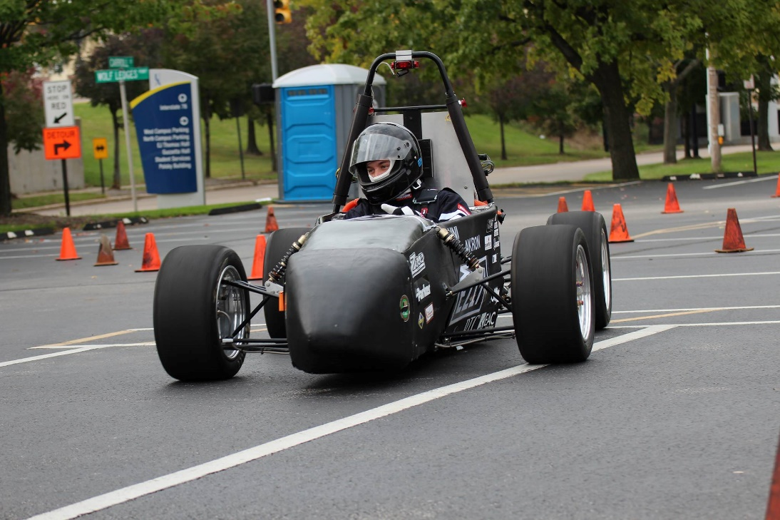
Project Overview
We are a student organization that designs and builds an all electric F1 style race car from the ground up.
Our team not only designs and builds the mechanical system (suspension, frame and uprights), but also the entire electrical system including Battery Management, Telemetry and a host of others, along with writing all the associated embedded software.

Slide 3
Electrical System Overview
ALL HARDWARE IS DESIGNED BY STUDENTS & HAND ROUTED
Backplane – the car “motherboard”
Battery Management
Dashboard Display – car/driver interface electronics
ECU/MCS – motor & stability control
Intercom – pit crew and driver communication
Safety System – monitors car for safety issues
Sensor Acquisition System – monitors sensors and checks for faults
Telemetry – collects and transmits sensor data to server

Slide 4
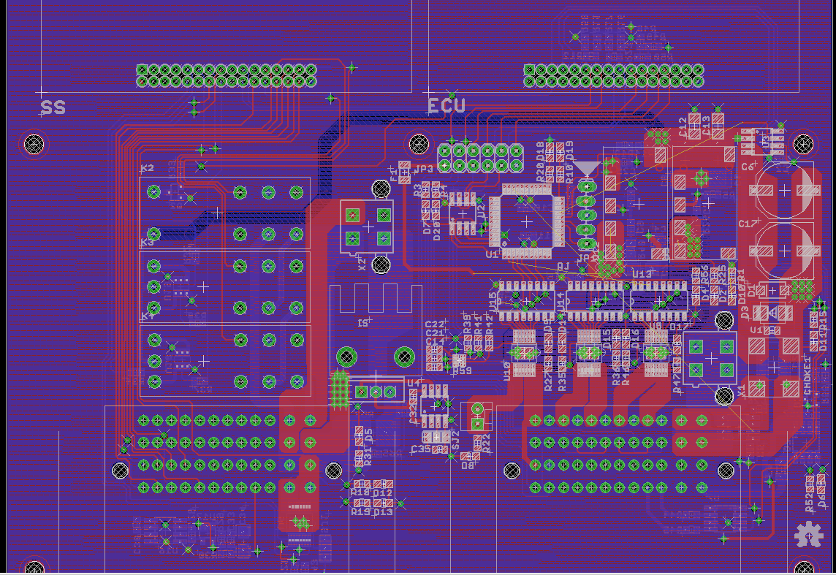
Backplane
Motherboard for the car
Accepts modular expansion cards including:
Safety System
ECU
Power Distribution
Drive Modes
Acceleration
Eco
Sport

Slide 5
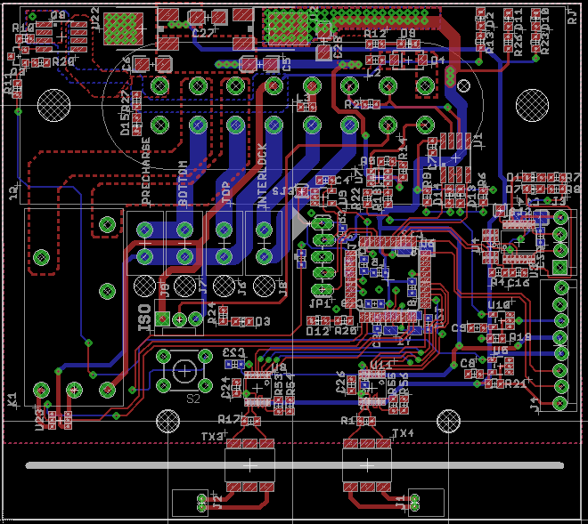
Battery Management Master
High Voltage Master
High efficiency multi-segment monitoring & control
Low power consumption with 1 year shelf life
Interprets battery health and controls our 300 volt, 216 cell battery pack

Slide 6
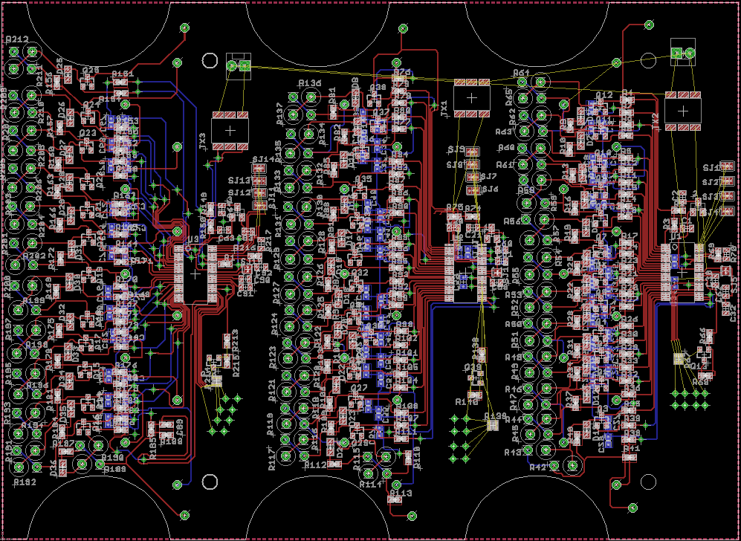
Battery Management HV
High Voltage Boards (6 boards, 1 per 36 cell segment)
Charging & Bypass control
Cell Health Monitoring
Cell Voltage Monitoring
Cell Temperature Monitoring

Slide 7
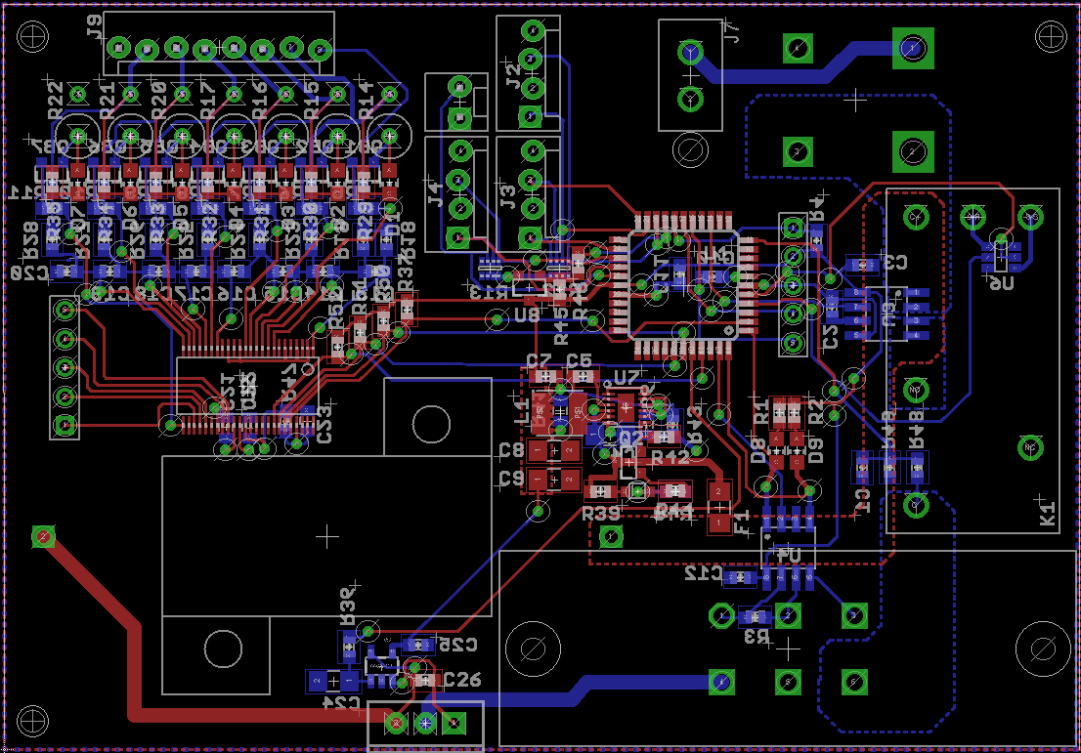
Battery Management LV
Low Voltage – Single Battery Pack
Charging & Bypass control
Cell Health Monitoring
Cell Voltage Monitoring
Cell Temperature Monitoring

Slide 8
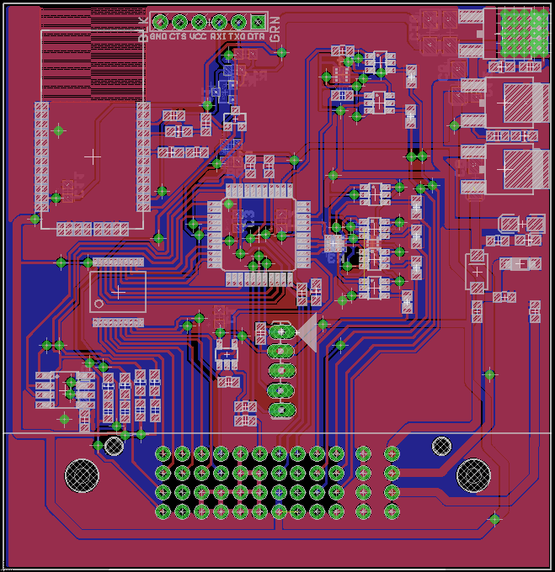
Dashboard Display
Controls Dashboard & Driver Interface including:
Steering wheel Buttons
LED status indicators
LCD Display

Slide 9
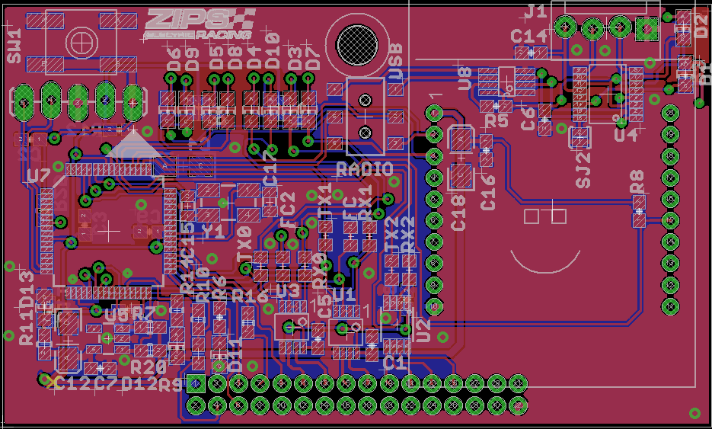
ECU/MCS
Controls Drive signals and Traction control
Controls Cooling Pump & Fan
Master Communication Center
Expansion Card for Backplane

Slide 10
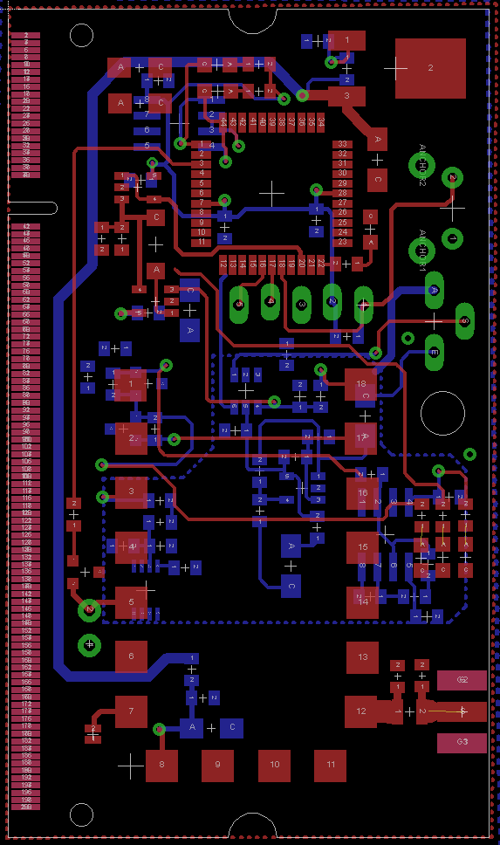
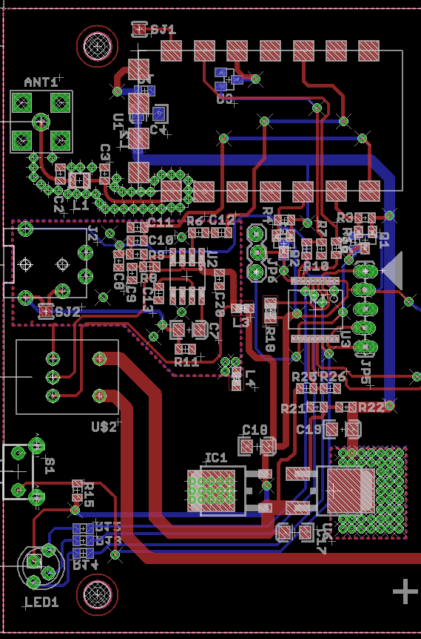
Intercom System
Driver Headset
Wireless link to pit crew
Real time updates
Pit Crew Headsets
Provide track info & Important car stats

Slide 11
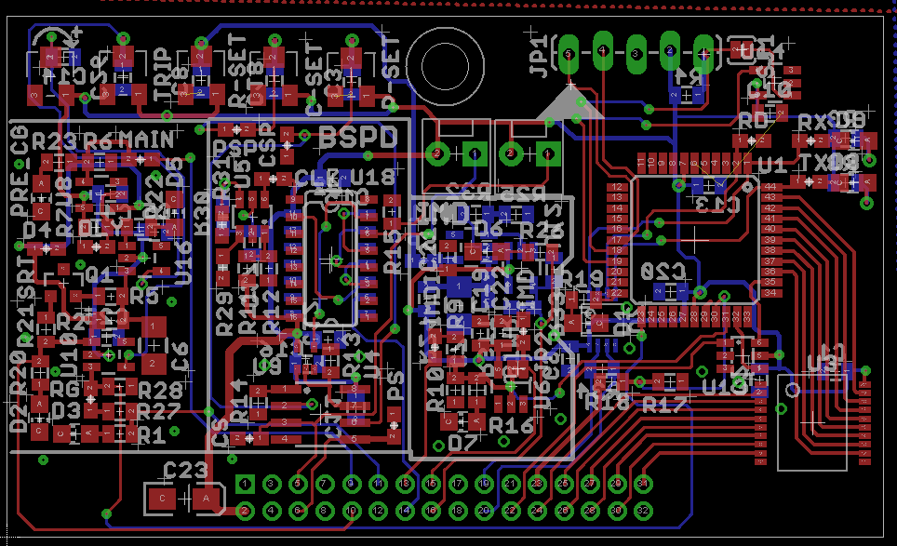
Safety System
Monitors Safety System
Emergency Stops
High Voltage Disconnect
Brake Overtravel
Inertial (Crash) Switch
Isolation Measurement

Slide 12
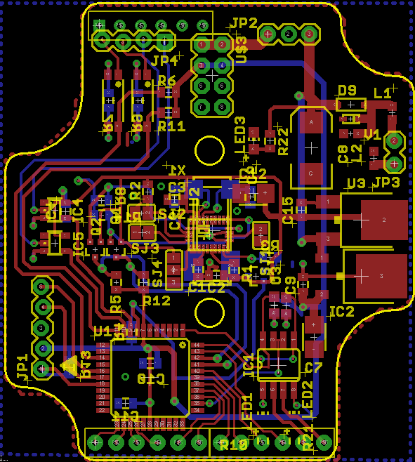
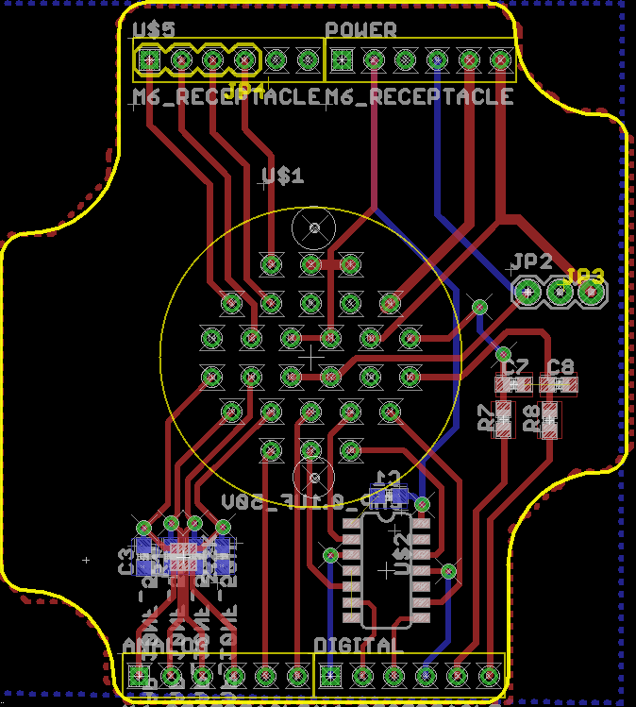
Telemetry System
Collects & Transmits Data back to server over 802.11
9 axis IMU
Shock Position Sensors
Brake Temperature Sensors
GPS

Slide 13
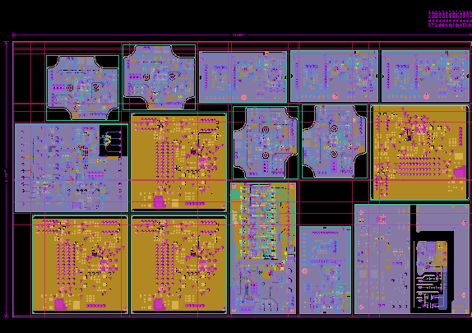
Panelized Boards
2 qty 4 layer Backplane (6”x6”)
10 qty (2 panels) Battery Management Boards (YTD)
All other boards (2 panel) (14.1” x 8.42”)

Slide 14
Questions?
Feel free to contact us with any questions!
Joseph Drockton
Electrical Engineer
jmd115@zips.uakron.edu
Trevin Hartzler
Team Captain
tah91@zips.uakron.edu
Richard Johnson
EE Consultant
rcj10@zips.uakron.edu

Slide 15
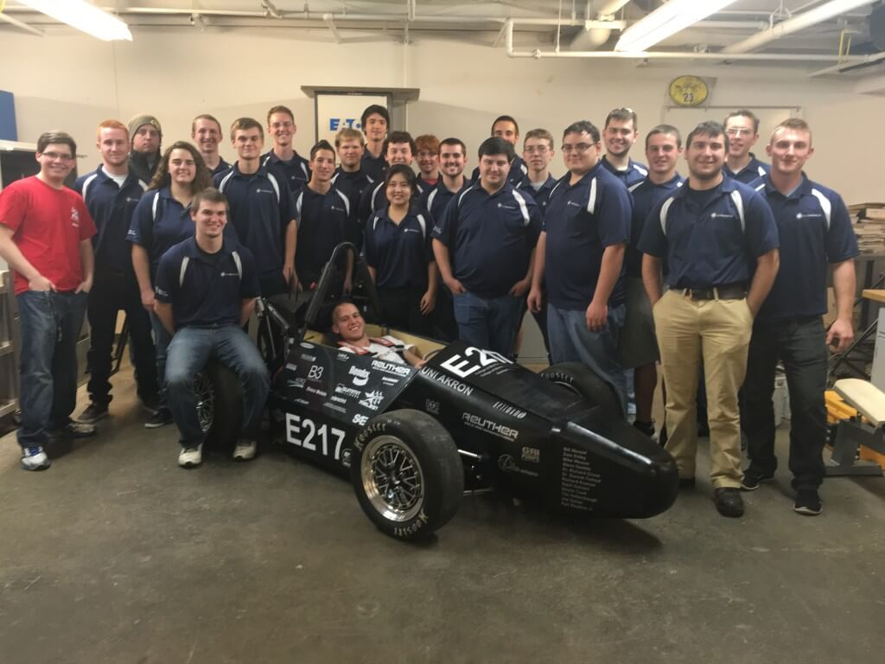
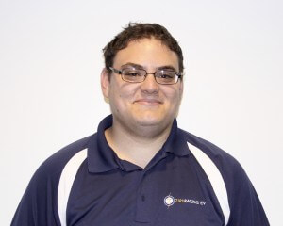
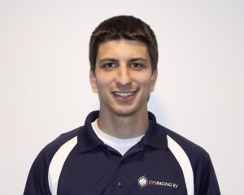
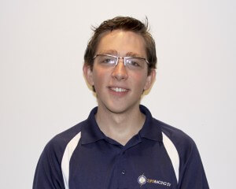
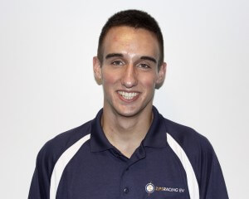
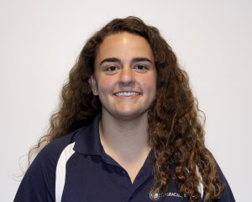

Thank You, from & our Electrical Engineering Squad
Richard Johnson
Joseph Drockton
Trevin Hartzler
Grant Reinbolt
Adrianna Dunlap
Gregory Synek

